Slide 1
Multi-family Homes in Single Family Zones

Slide 2
What is a Dwelling Unit?
Dwelling Unit
nounformal
/ˈdweliNG ˈyo͞onət/ dwell·ing u·nit
One or more rooms in a dwelling designed for occupancy by one family for living or sleeping purposes and having only one kitchen.
Notes:
(Ord. 388 Art. 1 (part), 1975)

Slide 3
What is a Single Family Home?
Single Family Home
noun
sin·gle fam·i·ly home /ˈsiNGɡəlˈfam(ə)lē hōm/
One- family dwelling when used in the context of, design, development, construction, or remodeling means a detached building, containing one kitchen, designed exclusively to house not more than one family, including all necessary employees of such family.
When used in the context of, the use of a building or portion thereof, “one family dwelling” means used exclusively for residential occupancy by not more than one family, including all necessary employees of such family.
Notes:
(Ord. 687 § 2, 1990; Ord. 388 Art. 1 (part), 1975)

Slide 4
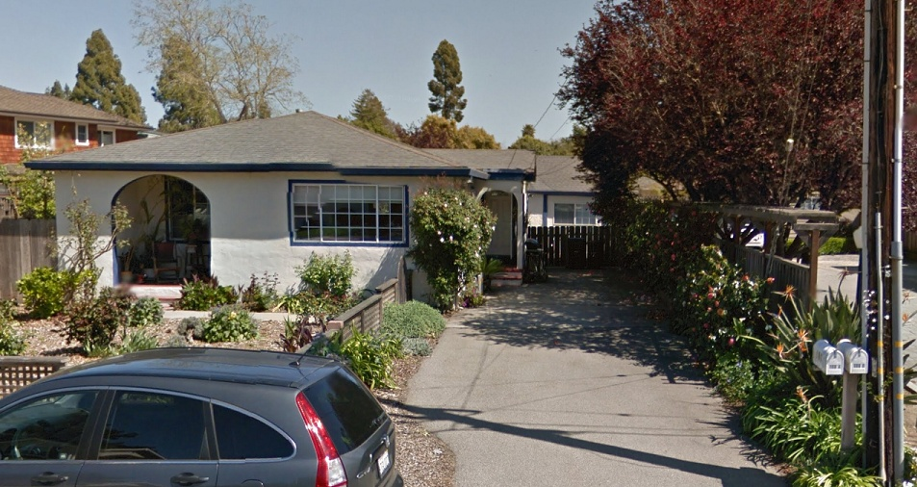
What is a Multi-family Structure?
Single family home with secondary dwelling units

Slide 5
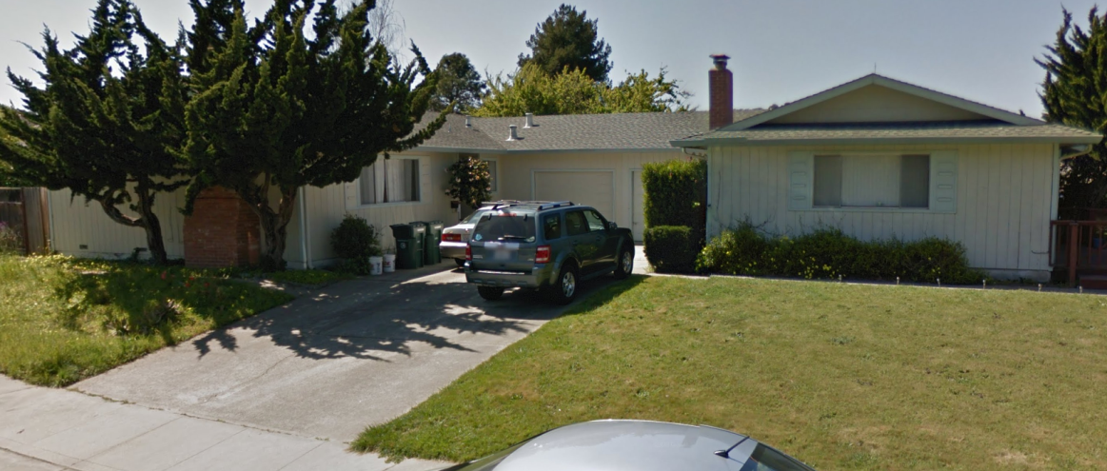
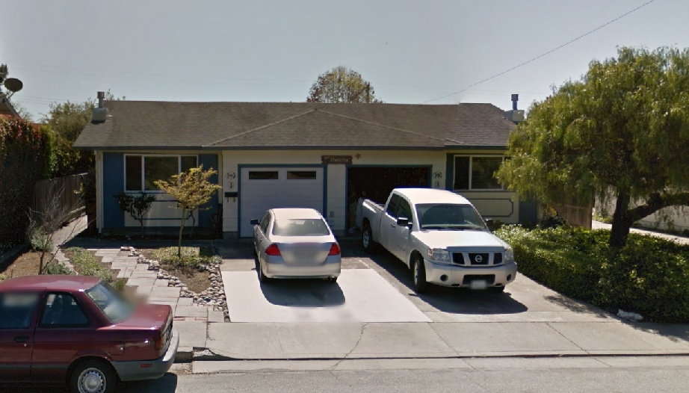
What is a Multi-family Structure?
Duplex

Slide 6
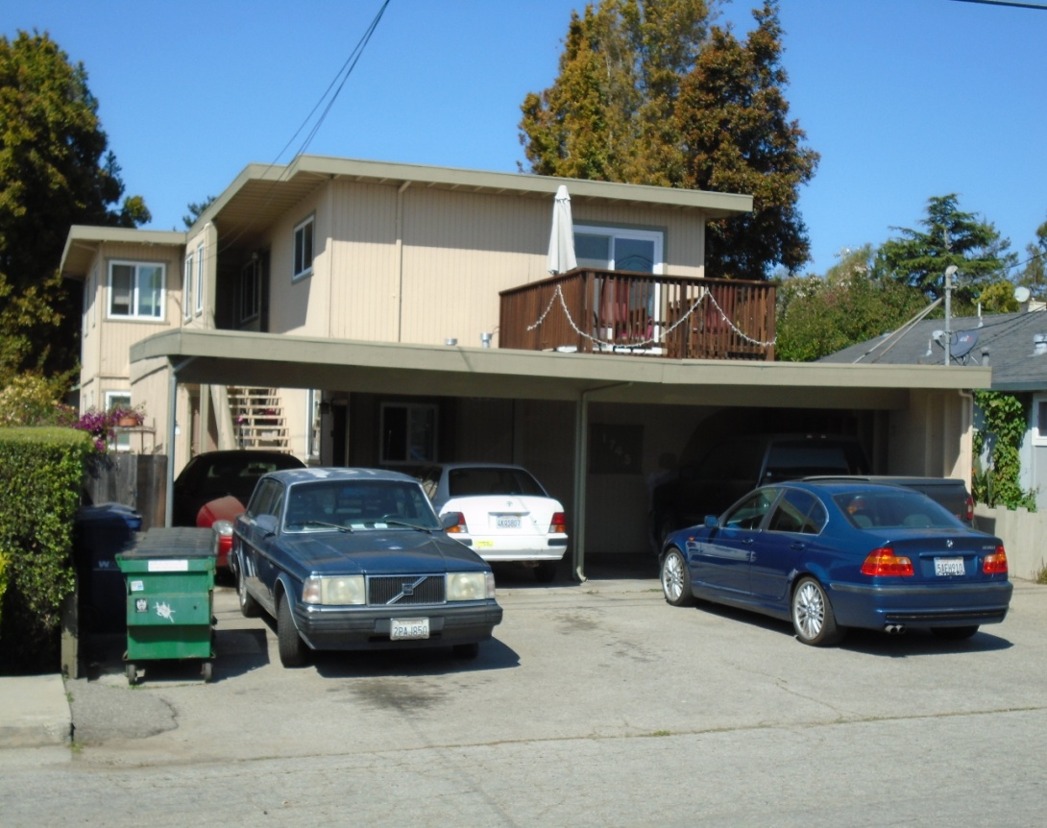
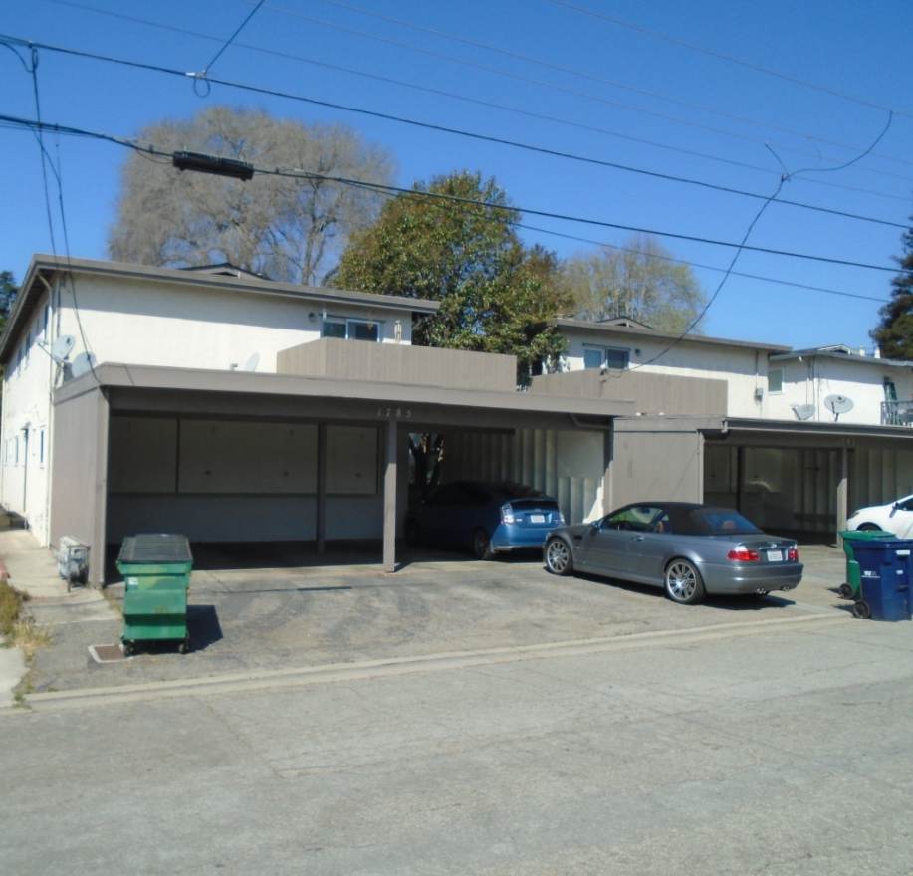
What is a Multi-family Structure?
Multi-family Structure: 3 or more dwelling units
Notes:
Upper jewel box

Slide 7
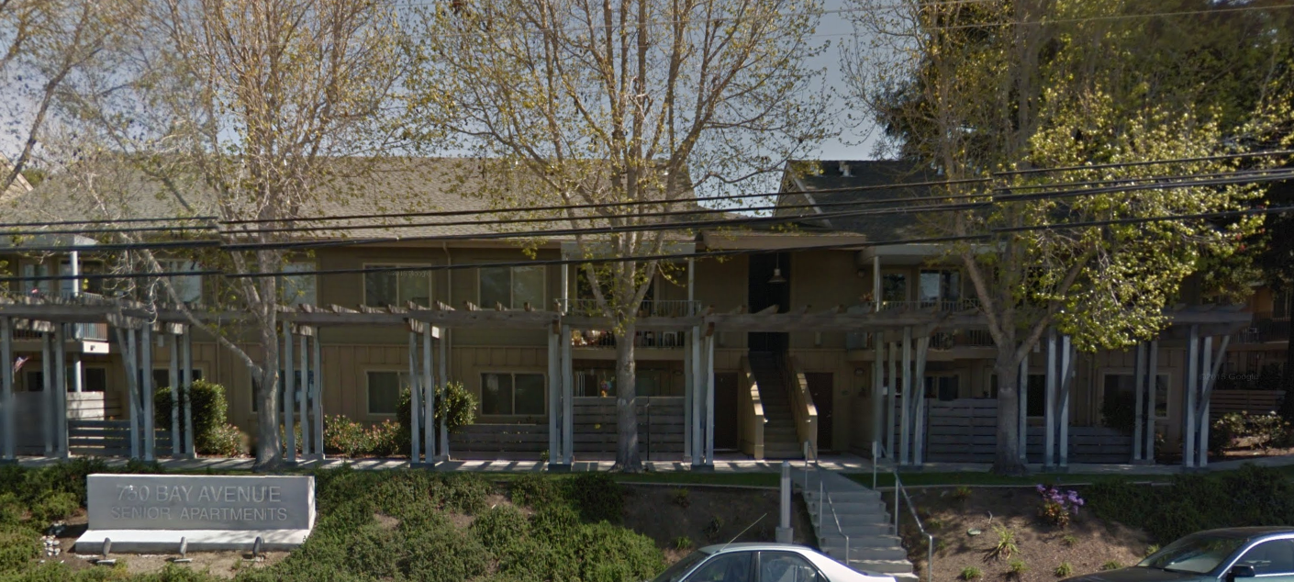
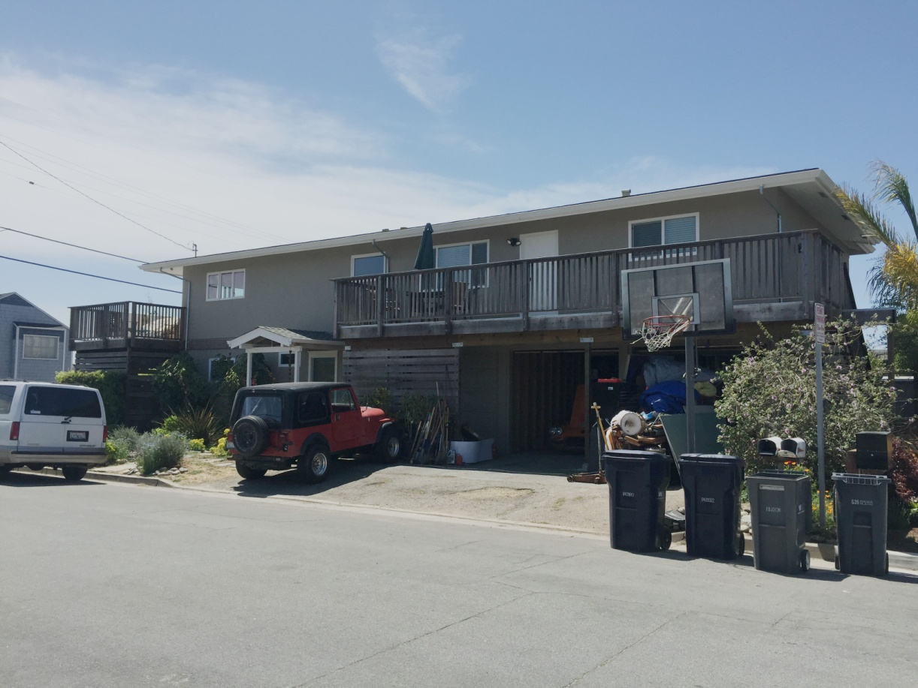
What is a Multi-family Structure?
Multi-family Structure: 3 or more dwelling units
Notes:
5080 Garnet
5060 Jewel Street

Slide 8
Current Zoning Code
Multi-family structures with 3 or more units in a single family zone are non-conforming
Nonconforming
verb
non·con·form·ing \-kən-ˈfȯrm/
an activity which was legal at the time established but not presently a permitted or conditional use in the zone.
Notes:
(Ord. 761 § 2, 1993; Ord. 388 Art. 1 (part), 1975)

Slide 9
Current Zoning Code
Non-conforming multi-family homes must be discontinued or apply for an extension 50 years from the date the property became non-conforming, or June 26, 2019, whichever date is later.
(Ord. 764 § 1, 1994; Ord. 761 § 1, 1993)

Slide 10
City of Capitola
City of Capitola
Changed to Single Family Zone
 |  |  | Single Family Zone

Slide 11
City of Capitola
City of Capitola
Changed to Single Family Zone
 |  |  | Single Family Zone
 | 1951 |  | Extension by 2019

Slide 12
City of Capitola
City of Capitola
Changed to Single Family Zone
 |  |  | Single Family Zone
 | 1951 |  | Extension by 2019
 | 1976 |  | Extension by 2026

Slide 13
City of Capitola
City of Capitola
Changed to Single Family Zone
 |  |  | Single Family Zone
 | 1951 |  | Extension by 2019
 | 1976 |  | Extension by 2026
 | 1979 |  | Extension by 2029

Slide 14
City of Capitola
Changed to Single Family Zone
 |  |  | Single Family Zone
 | 1951 |  | Extension by 2019
 | 1976 |  | Extension by 2026
 | 1979 |  | Extension by 2029
 | 1984 |  | Extension by 2034

Slide 15
Public Outreach
June 15, 2015 – Public Workshop
40 Attendees
Online Survey
Mailed to owners in R-1 within 300 ft
77 Participants

Slide 16
Survey Results: All Respondents

Slide 17
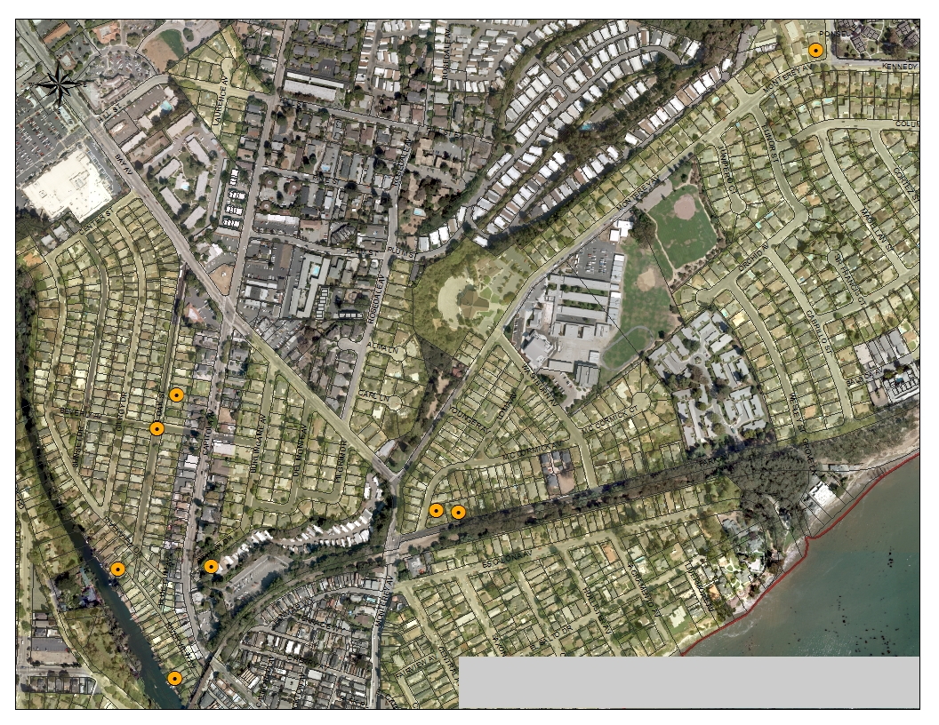
Riverview to Monterey

Slide 18
Riverview to Monterey

Slide 19
Riverview to Monterey
How would you suggest the City of Capitola treat existing multi- family uses in single family neighborhoods?
Options | Survey Results | Workshop Results | Total
Keep the current Code | 1 | 0 | 1
Removed the required extension and allow multi-family uses to continue indefinitely provided they do not increase in size of number units | 8 | 1 | 9
Add to the existing requirement that the City Council may require the removal of units to address issues that cannot be addressed due to limited space on the site such as adequate onsite parking | 1 | 0 | 1
Rezone areas with high concentrations of structured with 3+ units from single-family zoning to multi-family zoning | 1 | 1 | 2
All Multi-family uses in single family neighborhoods should discontinue by 2019 and the extension process should b removed from the code | 4 | 0 | 4
Other | 2 | 0 | 2

Slide 20
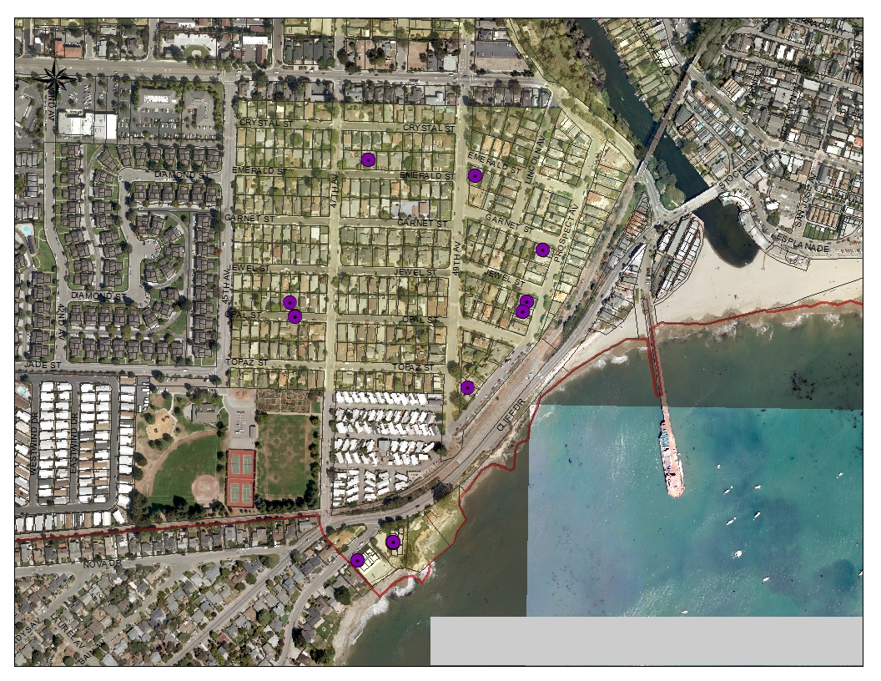
Jewel Box

Slide 21
Jewel Box

Slide 22
Jewel Box
How would you suggest the City of Capitola treat existing multi- family uses in single family neighborhoods?
Options | Survey Results | Workshop Results | Total
Keep the current Code | 5 | 0 | 5
B. Removed the required extension and allow multi-family uses to continue indefinitely provided they do not increase in size of number units | 7 | 4 | 11
C. Add to the existing requirement that the City Council may require the removal of units to address issues that cannot be addressed due to limited space on the site such as adequate onsite parking | 1 | 0 | 1
D. Rezone areas with high concentrations of structured with 3+ units from single-family zoning to multi-family zoning | 1 | 0 | 1
E. All Multi-family uses in single family neighborhoods should discontinue by 2019 and the extension process should b removed from the code | 4 | 0 | 4
F. Other | 1 | 0 | 1

Slide 23
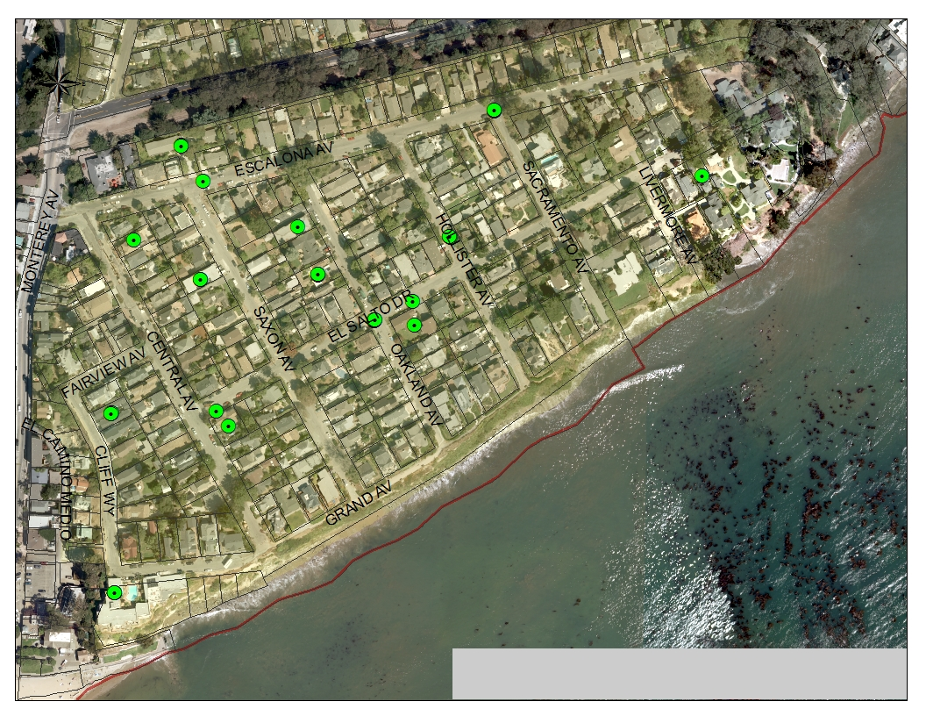
Depot Hill

Slide 24
Depot Hill

Slide 25
Depot Hill
How would you suggest the City of Capitola treat existing multi- family uses in single family neighborhoods?
Options | Survey Results | Workshop Results | Total
Keep the current Code | 3 | 0 | 3
B. Removed the required extension and allow multi-family uses to continue indefinitely provided they do not increase in size of number units | 4 | 0 | 4
C. Add to the existing requirement that the City Council may require the removal of units to address issues that cannot be addressed due to limited space on the site such as adequate onsite parking | 4 | 0 | 4
D. Rezone areas with high concentrations of structured with 3+ units from single-family zoning to multi-family zoning | 0 | 0 | 0
E. All Multi-family uses in single family neighborhoods should discontinue by 2019 and the extension process should b removed from the code | 5 | 0 | 5
F. Other | 0 | 6 | 6

Slide 26
North of Capitola Road

Slide 27
North of Capitola Road
Notes:
Public Workshop Results:
May allow for more affordable housing
Adds diversity to neighborhood
Adds diversity to schools
Diversity is good
Affordable housing is good
We need more low income housing in Capitola for seniors, students, working families, and people with disabilities
Public Workshop Results:
Over stuffed with parking especially as compared to parking requirements for single family homes
And as a result of above, frequent noise from rearranging the cars
Parking under carports is single file, with one car parked behind another and often hang out into street
Carport design with parking as described above negates the possibility of a viable sidewalk
Apartments seem shoddily built and their designs wouldn’t pass muster by current standard
Apartments, with some exception, aren’t maintained to the standards most of the other homes on the street
Patio decks above the carports are noisy and impede privacy on homes across the street
Carports are loud echo chambers affecting the houses across the street
Carports are often used for storage in an unsightly way
Garbage cans and dumpsters are a constant blight and pest buffet table
The fourplex on 47th & 48th Ave are health hazards in every single sense of the world. Holes in drive, trash spilled everywhere, over occupied, run-down construction, etc. They are dangerous
*yes people are walking sitting, sun bathing on the flimsy carport roofs (not on patio deck).
When two or more non-conforming multi-family units are located next to each other (ie 1710, 1720, 1730 48th Ave.) then the compound effects are multiplied exponentially. Three units (two four plexes and one 3 three plex) equals 20 plus car

Slide 28
North of Capitola Road
How would you suggest the City of Capitola treat existing multi- family uses in single family neighborhoods?
Options | Survey Results | Workshop Results | Total
Keep the current Code | 2 | 0 | 2
B. Removed the required extension and allow multi-family uses to continue indefinitely provided they do not increase in size of number units | 4 | 2 | 6
C. Add to the existing requirement that the City Council may require the removal of units to address issues that cannot be addressed due to limited space on the site such as adequate onsite parking | 0 | 2 | 2
D. Rezone areas with high concentrations of structured with 3+ units from single-family zoning to multi-family zoning | 0 | 1 | 1
E. All Multi-family uses in single family neighborhoods should discontinue by 2019 and the extension process should b removed from the code | 10 | 0 | 10
F. Other | 1 | 0 | 1
Notes:
Public Workshop Results:
May allow for more affordable housing
Adds diversity to neighborhood
Adds diversity to schools
Diversity is good
Affordable housing is good
We need more low income housing in Capitola for seniors, students, working families, and people with disabilities
Public Workshop Results:
Over stuffed with parking especially as compared to parking requirements for single family homes
And as a result of above, frequent noise from rearranging the cars
Parking under carports is single file, with one car parked behind another and often hang out into street
Carport design with parking as described above negates the possibility of a viable sidewalk
Apartments seem shoddily built and their designs wouldn’t pass muster by current standard
Apartments, with some exception, aren’t maintained to the standards most of the other homes on the street
Patio decks above the carports are noisy and impede privacy on homes across the street
Carports are loud echo chambers affecting the houses across the street
Carports are often used for storage in an unsightly way
Garbage cans and dumpsters are a constant blight and pest buffet table
The fourplex on 47th & 48th Ave are health hazards in every single sense of the world. Holes in drive, trash spilled everywhere, over occupied, run-down construction, etc. They are dangerous
*yes people are walking sitting, sun bathing on the flimsy carport roofs (not on patio deck).
When two or more non-conforming multi-family units are located next to each other (ie 1710, 1720, 1730 48th Ave.) then the compound effects are multiplied exponentially. Three units (two four plexes and one 3 three plex) equals 20 plus car

Slide 29
Owner/Occupant Multi-family Home
VS.
Owner/Occupant of Single-family Home or Duplex

Slide 30
Owner/Occupant Multi-family Home
VS.
Owner/Occupant of Single-family Home or Duplex
How would you suggest the City of Capitola treat existing multi- family uses in single family neighborhoods?
Options | Survey Results: Owner/Occupant of Multi-family Home | Survey Results: Owner/ Occupant of single family home or duplex
Keep the current Code | 0 (0%) | 11 (19%)
B. Removed the required extension and allow multi-family uses to continue indefinitely provided they do not increase in size of number units | 10 (91%) | 13 (22%)
C. Add to the existing requirement that the City Council may require the removal of units to address issues that cannot be addressed due to limited space on the site such as adequate onsite parking | 0 (0%) | 6 (10%)
D. Rezone areas with high concentrations of structured with 3+ units from single-family zoning to multi-family zoning | 1 (9%) | 2 (3%)
E. All Multi-family uses in single family neighborhoods should discontinue by 2019 and the extension process should b removed from the code | 0 (0%) | 22 (38%)
F. Other | 0 (0%) | 4 (7%)

Slide 31
Options
A. Keep the current Code
B. Removed the required extension and allow multi-family uses to continue indefinitely provided they do not increase in size of number units
C. Add to the existing requirement that the City Council may require the removal of units to address issues that cannot be addressed due to limited space on the site such as adequate onsite parking
D. Rezone areas with high concentrations of structured with 3+ units from single-family zoning to multi-family zoning
E. All Multi-family uses in single family neighborhoods should discontinue by 2019 and the extension process should b removed from the code
F. Other

